Slide 1
Mimicking Nature via Self-Assembly
Matthew J. Patitz
Department of Computer Science and Computer Engineering
University of Arkansas
6/25/2012

Slide 2

























































Introduction to self-assembly
Q: What is self-assembly?
A: The process by which relatively simple components in a disorganized state autonomously combine to form more complex objects

Slide 3
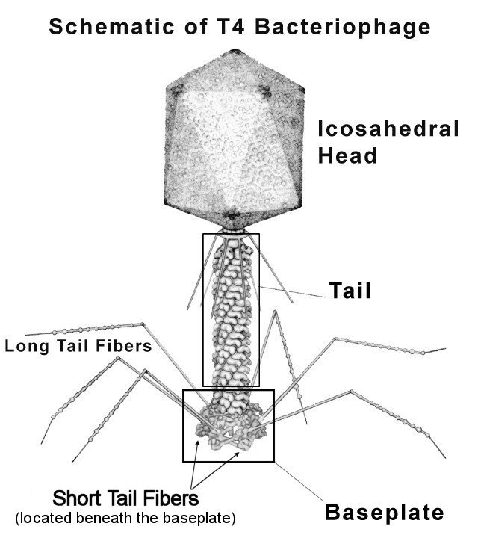
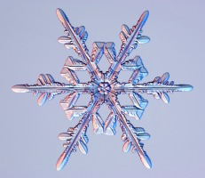
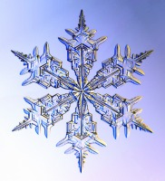
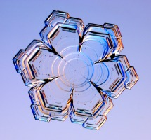
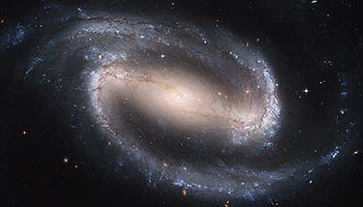
Introduction to self-assembly
Q: What is self-assembly?
Q: What self-assembles?
(besides Razorbacks…)
A: The process by which relatively simple components in a disorganized state autonomously combine to form more complex objects
A: Many structures at many scales!
Examples include:
  Crystals (such as snowflakes)
  Biological structures (e.g. viruses)
  Cosmic structures (e.g. galaxies)
Images courtesy of SnowCrystals.com
Image courtesy of NSF.gov
Image courtesy of hubblesite.org

Slide 4
Introduction to self-assembly
Q: What is self-assembly?
Q: What self-assembles?
(besides Razorbacks…)
A: The process by which relatively simple components in a disorganized state autonomously combine to form more complex objects
A: Many structures at many scales!
Examples include:
  Crystals (such as snowflakes)
  Biological structures (e.g. viruses)
  Galaxies
Q: Why study self-assembly?
A: Several reasons:
  Better understand origin and functioning of living systems
  Mathematically interesting properties
  Eventual creation of ‘fantastic’ technologies

Slide 5
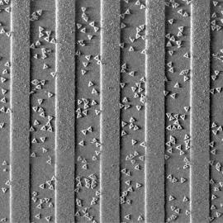
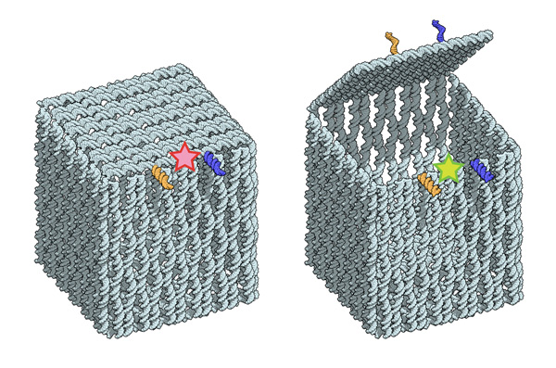
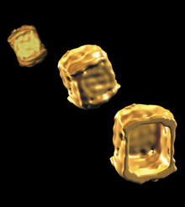
Toward “fantastic” technologies
Atomically-precise manufacturing
  IBM-Caltech collaboration using self-assembled molecules to guide fabrication of next-gen processors
Nano biomedical devices
  Aarhus University Center for DNA Nanotechnology’s box with programmable lid
Credit: PRNewsFoto/IBM
Credit: : Ebbe S. Andersen, Aarhus University

Slide 6
Following in Mother Nature’s footsteps
Natural self-assembling systems span the spectrum of complexity
  From crystals (passive components with simpler geometries)
  To biology (active components with more complex geometries)
Our methodology has been to start “simple” and build to complexity
  Driven by experimental viability and desire for firm theoretical understanding
We will begin with the simplest model and build to more complex and powerful models…

Slide 7

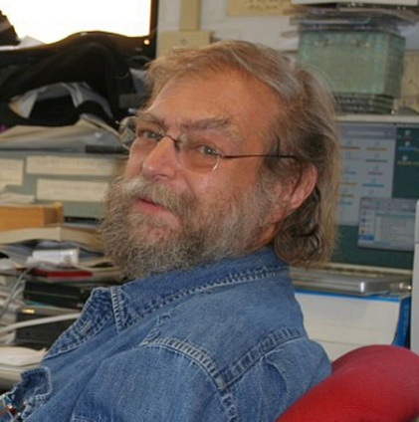

Tile Assembly Model
Erik Winfree introduced the Tile Assembly Model (TAM) in 1998
The TAM is based on experimental work with DNA molecules by Ned Seeman
It was later refined by Paul Rothemund
* Both Winfree and Rothemund have both been named
MacArthur Fellows

Slide 8
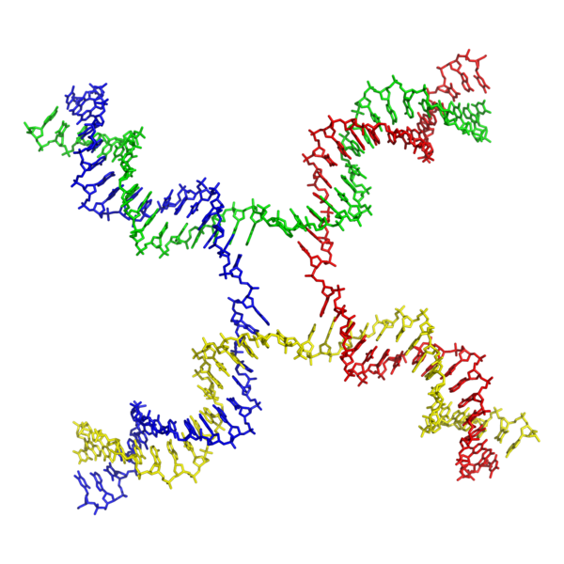
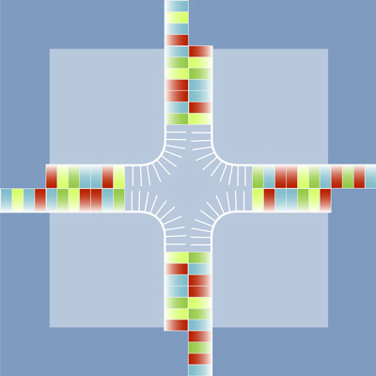

Tile Assembly Model
DNA molecules formed into shapes such as Holliday junctions can be treated logically as 2-dimensional squares
Schematic view of Holliday junction with extended ‘sticky ends’
Molecular structure of a Holliday junction
(Image courtesy of Wikipedia)
With the ‘sticky ends’ treated as glues, these molecules can be thought of as square ‘tiles’

Slide 9
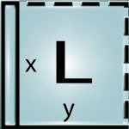

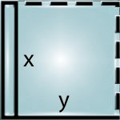
Tile Assembly Model
Strength 0
Strength 1
Strength 2
Fundamental components are 2-D square tiles
Each side has an associated glue, with:
  A type (usually represented by a string value)
  An integer-valued strength (usually 0, 1, or 2)
Tiles can also have labels (non-functional, for convenience)
Tiles cannot be rotated
Finite number of different tile types
An infinite supply of each tile type
Abutting sides of tiles bind if both glue strengths and values match
  Those sides bind with that shared strength
  A tile can bind to an assembly if the sum of binding strengths is at least equal to the “temperature” value of the system (usually 1 or 2)
Assembly begins from a “seed” tile or assembly and grows 1 tile at a time

Slide 10
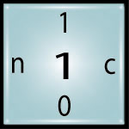
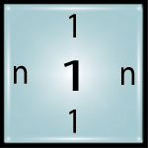
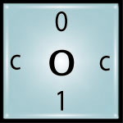
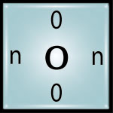

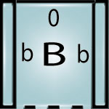
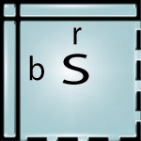
Tile assembly example
Tile set:
Strength 0
Strength 1
Strength 2
Temperature value = 2
Seed = (S, (0,0))

Slide 11
Tile assembly example
5
4
3
2
1
Attachment by 2 strength-1 bonds is a form of “cooperation” between multiple tiles that gives the model great power

Slide 12
Tile Assembly Model
How do we determine if a TAS is “good”?
  Tile complexity: How many unique tile types are required?
  Scale: Does it form a scaled version of the desired shape? If so, what is the scaling factor?
  It is directed – meaning that despite nondeterministic assembly sequences, it always produces the same thing
X
2
3
8
2
X
X
1
4
7
1
X
X
0
5
6
0
3
4
9 tile types
6 tile types!
Scale factor = 2

Slide 13


Tile Assembly Model
There are two main notions of the self-assembly of a set of points (defining a shape or pattern)
Strict self-assembly
Every point in the set, and no other point, receives a tile.
(Note that this means that the shape must be connected.)
Weak self-assembly
Every point in the set, and no other point, receives a tile of a type from a specially defined subset of tile types (e.g. `grey’ tile types). Other points may receive tiles of the other tile types.

Slide 14
Outline
Performing simulations in the aTAM
  Simulating a Turing machine
  Intrinsic universality
New models
  2-Handed Assembly Model
  Geometric tiles
  Signal tiles
  nBLOCKS

Slide 15
Turing Machine example
State: q₀
State: q₃
State: q₂
State: q₂
State: q₃
State: q₇
State: q₇
_
0
1
1
0
1
1
1
0
_

Slide 16

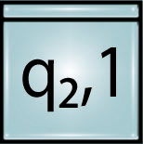
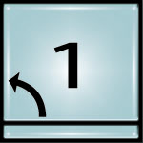

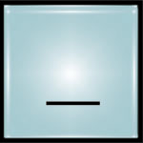
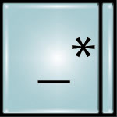
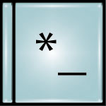
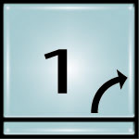
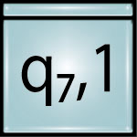
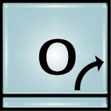
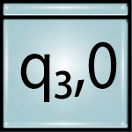
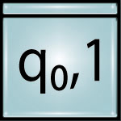
Turing Machine simulation in the TAM
State: q₀
State: q₃
State: q₂
State: q₂
State: q₃
State: q₇
State: q₇
_
0
1
1
0
1
1
1
0
_

Slide 17
Intrinsic Universality in Self-Assembly
Intrinsically universal (IU) model:
  A system within the model can simulate all other systems
  May require scaling
    Space and/or time
  A function exists to map the simulating system to the simulated system
  Must simulate full behavior, not just achieve same end result
IU models:
  Turing machines
  Cellular automata
  abstract Tile Assembly Model [Doty, Lutz, Patitz, Schweller, Summers, and Woods
    FOCS 2012 (53rd Annual IEEE Symposium on Foundations of Computer Science) to appear

Slide 18
2-Handed Assembly Model (2HAM)
Generalization of the TAM
  Tiles need not bind one at a time, but entire assemblies can combine in pairs
  Parallel assembly as in many natural systems
Producible assemblies (a.k.a. supertiles) are recursively defined:
  Singleton tiles are producible assemblies
  Any pair of producible assemblies which can be translated so that the sum of the binding strengths on adjacent edges ≥ temperature → producible assembly

Slide 19
2HAM Example
Temperature = 2

Slide 20
2HAM Example
Temperature = 2

Slide 21
2HAM: Pros and Cons
More realistic than the TAM?
  Multiple nucleation (assemblies aren’t required to all begin from a specially designated seed)
  How large and complex can supertiles become while still keeping a high likelihood of moving around enough to combine?
Provides a powerful new design tool: geometric hindrance

Slide 22
2HAM and Geometric Hindrance

Slide 23
2HAM and Geometric Hindrance

Slide 24
TAM vs. 2HAM
The 2HAM can simulate the TAM!
TAM Systems | 2HAM Systems
Temperature 1 & 2 | Temperature 2, Scale factor 5
Temperature 3 | Temperature 3, Scale factor 5
Temperature > 3 | Temperature 4, Scale factor 5
Two Hands Are Better Than One (up to constant factors), Sarah Cannon, Erik D. Demaine, Martin L. Demaine, Sarah Eisenstat, Matthew J. Patitz, Robert Schweller, Scott M. Summers, Andrew Winslow. Under submission.

Slide 25
Geometric Tiles
The square tiles of the TAM have a restricted range of interactions with each other
Proteins have extremely complex geometries which determine cross compatibilities
By adding rigid geometries to tile faces, more complex interaction functions can be realized
a
a
a
b
a
a
a
a
Sungwook Woo and Paul W.K. Rothemund, Stacking bonds: Programming molecular recognition based on the geometry of dna nanostructures, Nature Chemistry (2011).
Masayuki Endo, Tsutomu Sugita, Yousuke Katsuda, Kumi Hidaka, and Hiroshi Sugiyama, Programmed-assembly system using DNA jigsaw pieces, Chemistry: A European Journal (2010), 5362-5368.
a
c
a
a

Slide 26
Geometric Tiles
  We introduced the Geometric Tile Assembly Model
  Self-Assembly with Geometric Tiles, Bin Fu, Matthew J. Patitz, Robert T. Schweller, and Bobby Sheline. (ICALP 2012)
  Provided an upper bound on tile complexity for constructing an n x n square of sqrt(log(n)) which matches the information theoretic lower bound
    Better than the log(n)/log(log(n)) required in the TAM
  In a 2HAM version with very complex geometries, we presented a construction using log(log(n)) tile types!
  Tradeoff: decreasing tile type complexity for increasing complexity of the tiles themselves

Slide 27
Signaling Tiles
In self-assembling biological systems, components often change conformation and binding properties as assembly progresses
  Binding by molecules at one region of a protein may affect that protein’s binding affinity with other molecules at a distant region (e.g. hemoglobin)
(Exact replica!)

Slide 28
Signaling Tiles
We’ve modeled such “active” self-assembly with the Signal Tile Assembly Model (STAM)
  Asynchronous Signal Passing for Tile Self-Assembly: Fuel Efficient Computation and Efficient Assembly of Shapes, Jennifer E. Padilla, Matthew J. Patitz, Raul Pena, Robert T. Schweller, Nadrian C. Seeman, Robert Sheline, Scott M. Summers, Xingsi Zhong. Submitted
  Guided by DNA strand displacement techniques (initial implementations are being attempted in Seeman’s lab)
  STAM developed to be independent of specific pyhsical implementation
    The binding of one glue can activate and de-activate other glues
    Multiple glues per side
    Highly asynchronous
    Constant number of signals/tile
a
a
b
b
  Results include the first known strict self-assembly of a fractal, along with “fuel efficient” Turing machine simulations

Slide 29
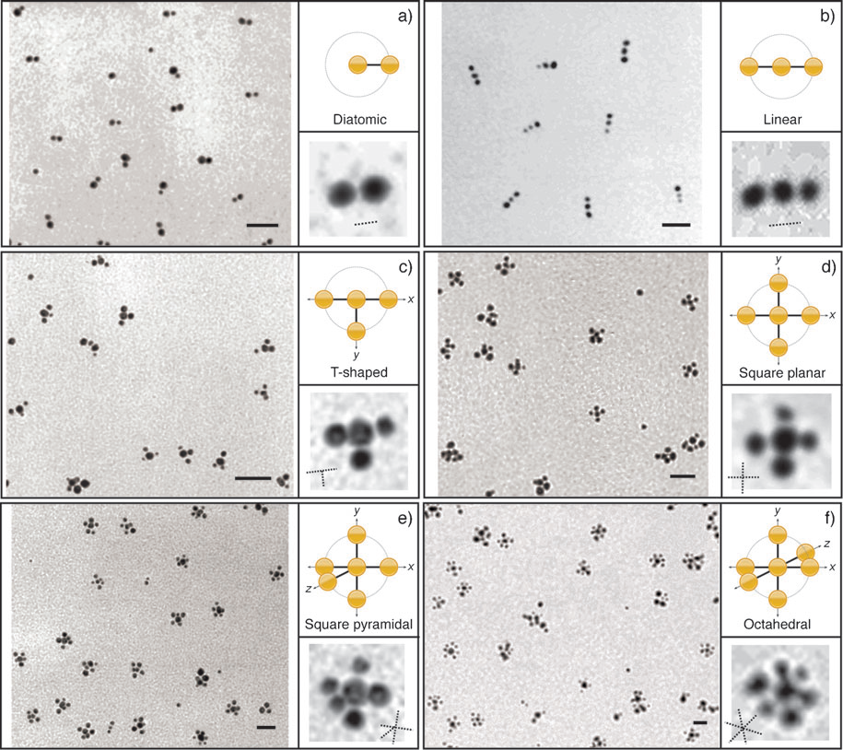
nBLOCKS
DNA-Linked Nanoparticle Building Blocks for Programmable Matter, Jin-Woo Kim, Jeong-Hwan Kim, and Russell Deaton. Angewandte Chemie, 2011
3-dimensional building blocks
1, 2, 3, 4, 5, or 6 DNA “arms”
Can incorporate a variety of materials
Easy to mass produce
Well-defined and controllable properties
Future work:
Develop theory and modeling
  Enhance simulator
Expand ability to assemble designed shapes
Create materials with designed properties

Slide 30
Thank you!

